Slide 1

Machine Learning approaches on Alzheimer’s Disease data
Suong Tran & Quang Nguyen

Slide 2
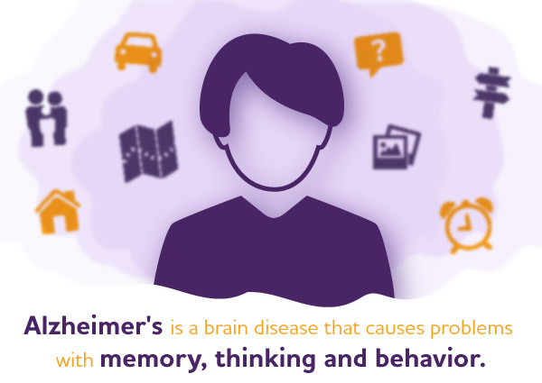
What is Alzheimer's Disease?

Slide 3

Motivation
Alzheimer's disease affects 6.7 million individuals aged 65 and older.
Without significant medical advancements to address this problem, the anticipated number of cases will be 13.8 million by 2060.
This highlight the urgent need for continued research and innovation in the field of dementia care.

Slide 4
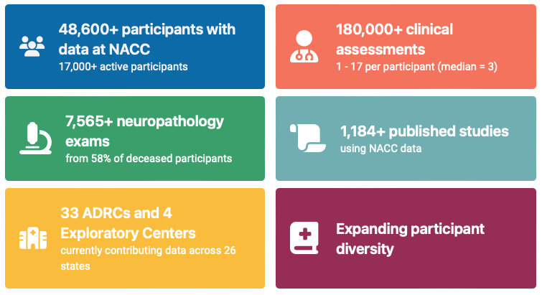
National Alzheimer’s Coordinating Center (NACC) data
Data used in our projects:
13689 patients’ data collected since 2005 during standardized annual evaluations conducted at the NIA-funded Alzheimer’s Disease Research Centers (ADRCs) across the country.
22 features selected based on literature review and easiness-to-understand for normal people.

Slide 5
Features
1) Demographic Factors:
Age (NACCAGE)
Sex
2) Lifestyle Factors:
BMI
Smoking Habits
3) Health Conditions:
Alcohol-related issues
Diabetes (presence or absence)
Hypertension (History/Presence)
Cardiovascular Health (Heart attack or cardiac arrest)
4) Cognitive Assessment:
CDRSUM (Standard CDR sum of boxes)
DECIN (Informant report of memory decline)
MOSLOW (Observations of slowed movement, expression changes)
Memory (CDR-based assessment)
5) Functional Activities:
SPEECH (Speech impairment)
BILLS (Difficulty in handling bills)
TRAVEL (Difficulty in traveling)
MOFALLS (Frequency of falls)
MOTREM (Rhythmic shaking)
No labeled data!

Slide 6
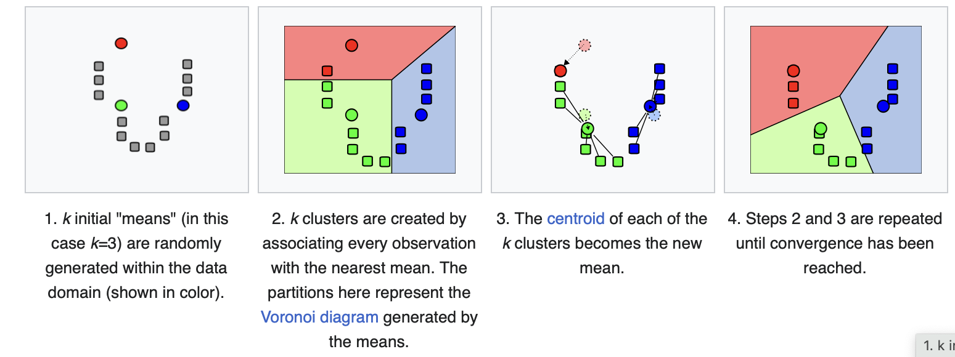
K-means clustering
Notes:
Salmon lightseagreen

Slide 7
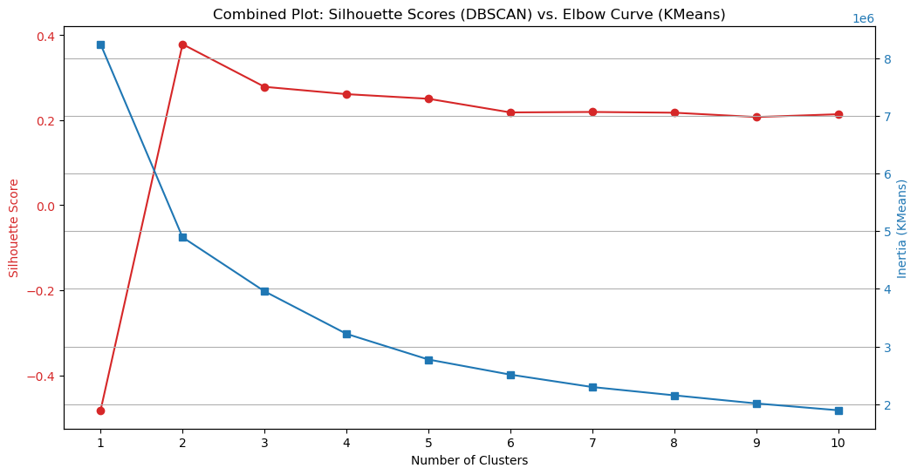
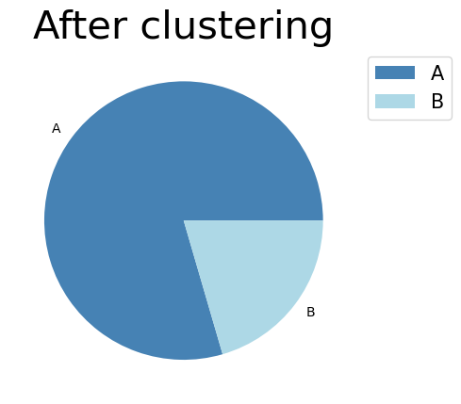
K-means clustering
Notes:
Salmon lightseagreen

Slide 8
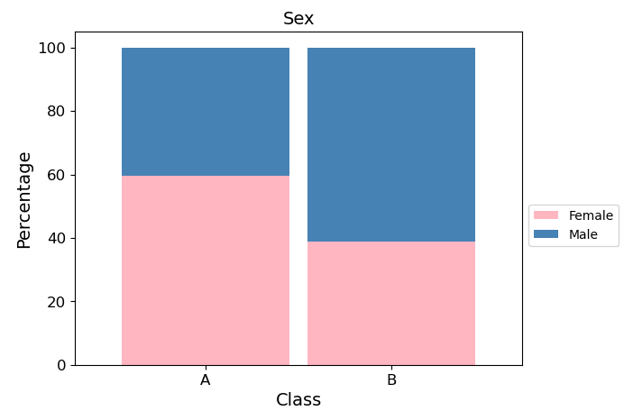
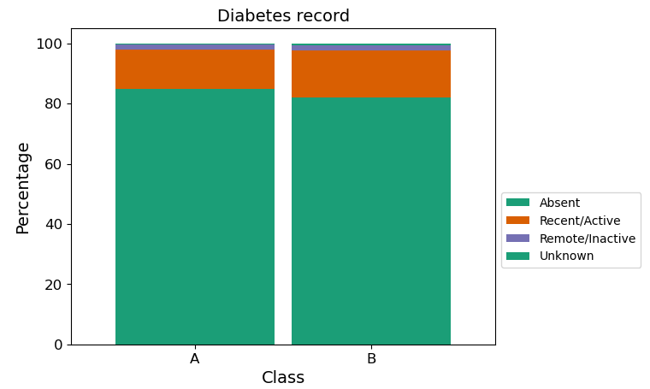
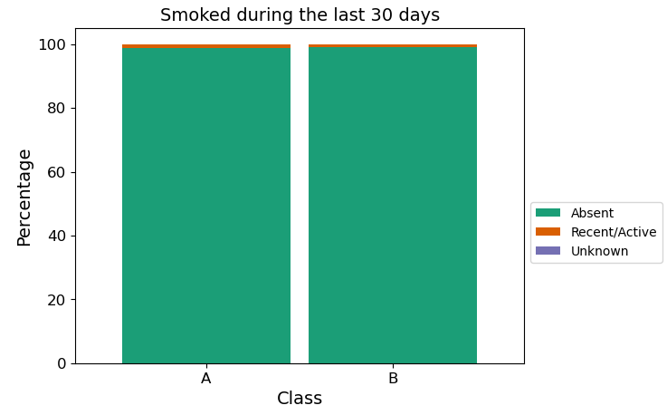
Insignificant factors
After clustering, it becomes apparent that the first three factor groups did not significantly contribute to the model, as the distribution of each category within these features is proportionally similar.
Demographic
Health condition
Lifestyle

Slide 9
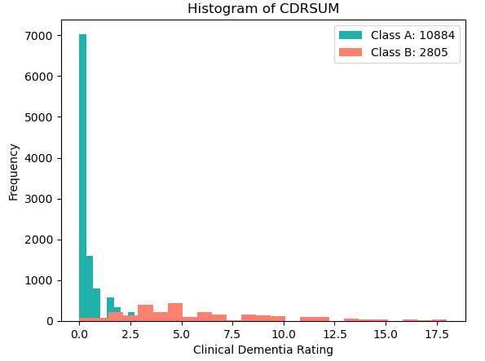
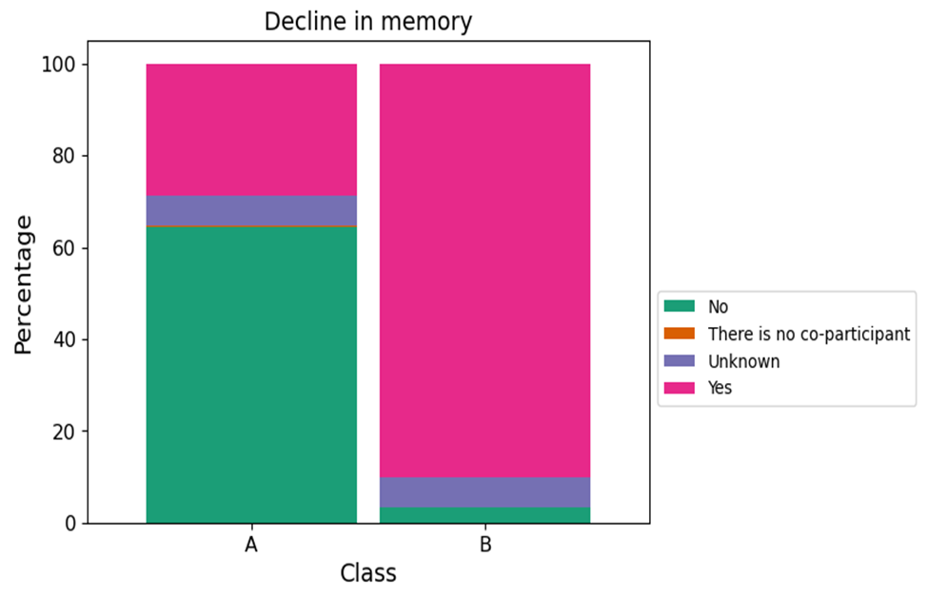
Cognitive Assesment
Class A:
For CDRSUM, most individuals are classified as normal on the clinical rating scale.
For memory decline, more than 60% of this class wasn't reported to have a decline in memory.
Class B:
For CDRSUM, more than half of this class have some degree of impairment.
For memory decline, almost all participants in this cluster are reported to have a decline in memory.

Slide 10
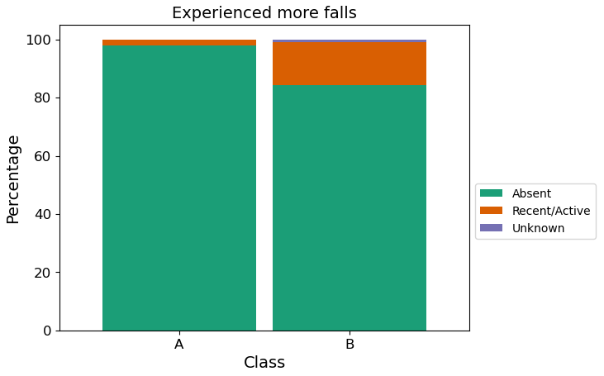
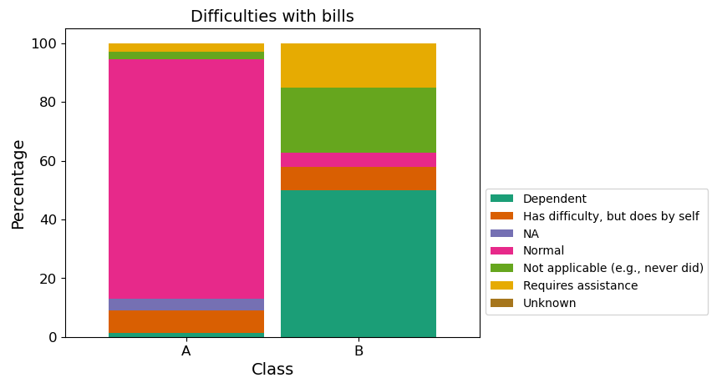
Functional Activities
Class A:
most individuals weren’t reported to fall more
a majority of this group encountered no difficulties in writing checks, paying bills, etc.
Class B:
the amount of people reported to experienced more fall is proportionally larger compared to class A.
most people in this group encountered difficulties at some levels when writing checks, paying bills, etc.

Slide 11

General conclusion
Class A appears to consist of individuals who are generally healthier, with fewer reported impairments in memory, motor function, speech, and activities of daily living.
Class B, on the other hand, seems to have consist of unhealthier people.
Both groups have similar patterns in terms of the first three feature groups, but class B tends to have slightly worse health outcomes overall.

Slide 12
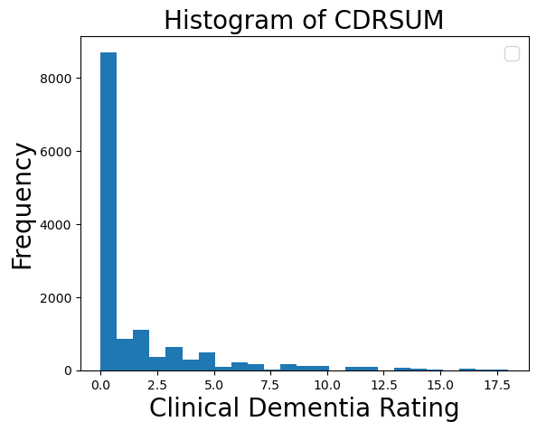
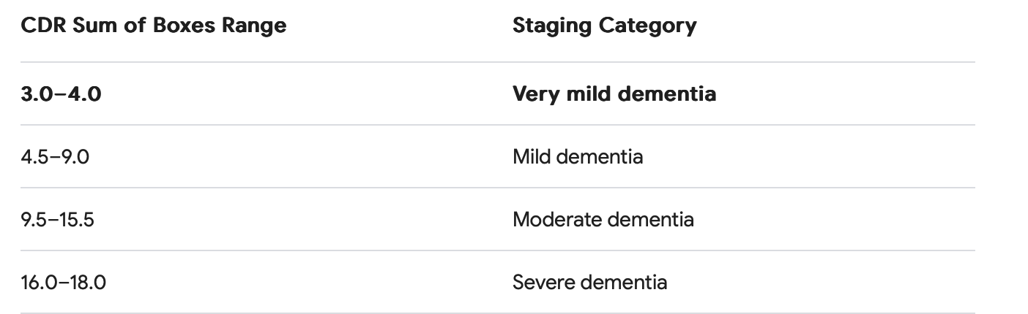
Supervised Learning
Goal: Predicting Clinical Dementia Rating Sum of Boxes (CDRSUM) with given features

Slide 13
Supervised Learning Models
Linear Regression
assume normally distributed data
no hyperparam-eter, easy to interpret
right-skewed (could be poisson or gamma distribution)
more zeros

Slide 14
Supervised Learning Models
Linear Regression
Random Forest Regression
Zero-inflated Regression
Tweedie Regression
assume normally distributed data
no assume about data distribution
accounts for the excessive number of zeros in the data
accounts for the excessive number of zeros in the data
can handle skewed distribution
can handle
non-linearity
no hyperparam-eter, easy to interpret
Use SVC as a “filter” to separate zero and non-zero values and then apply LR to non-zero values
right-skewed (could be poisson or gamma distribution)
more zeros

Slide 15
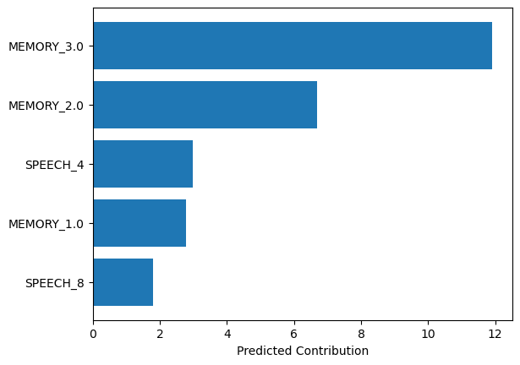
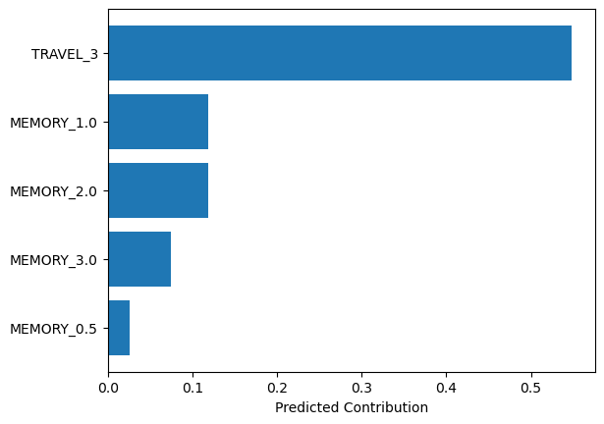
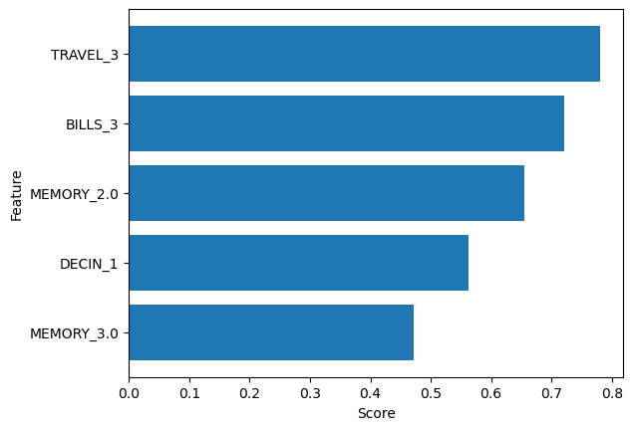
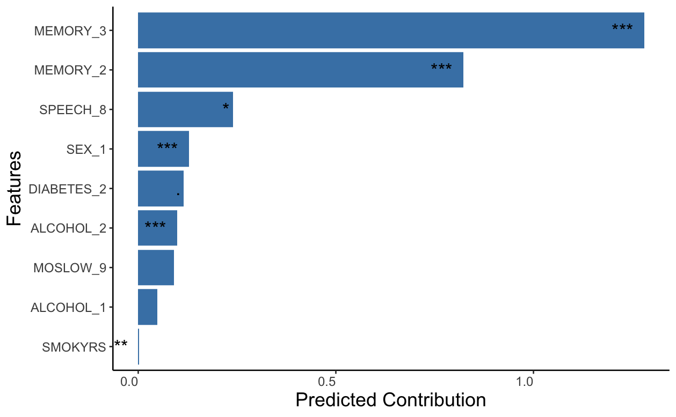
Linear Regression
Random Forest Regression
Data dictionary
MEMORY: 0.0: 'No impairment',
0.5: 'Questionable impairment',
1.0: 'Mild impairment',
2.0: 'Moderate impairment',
3.0: 'Severe impairment'
TRAVEL & BILLS
0 : 'Normal',
1 : 'Has difficulty, but does by self',
2 : 'Requires assistance',
3 : 'Dependent’
SPEECH:
0: 'Normal',
1: 'Slight loss of expression',
2: 'Moderately impaired',
3: 'Marked impairment',
4: 'Unintelligible',
8: 'Untestable’
SEX:
1: Male
ALCOHOL
0: Absent 1: Recent/Active 2: Remote/Inactive
Zero-inflated Regression
Tweedie Regression

Slide 16
Evaluation metrics
Model | Linear Regression | Random Forest Regressor | Zero-inflated Regressor | Tweedie Regression
Mean Squared Error (Lower is better) | 0.75 | 0.42 | 0.83 | 1.37
R-squared Score (Higher is better) | 0.91 | 0.95 | 0.90 | 0.84
Mean Absolute Error (Lower is better) | 0.46 | 0.25 | 0.45 | 0.61

Slide 17
Limitations
Cannot directly use classification algorithms to predict who has AD.
Having no validation for k-means clustering.
Human-involved in selecting features.
Future directions
Training more comprehensive models including other features.
Requesting alternative dataset that has label of who has AD, if possible.

Slide 18
Thank you for attending!
Do you have any questions?

